Slide 1
Biodiversity Capstone Project
Harrison Brooks -https://gist.github.com/cf5d3c5f239eb14963df68ea9e96a921
CodeAcademy Intensive 5/08/2018 - Data Analysis
Data Analysis

Slide 2
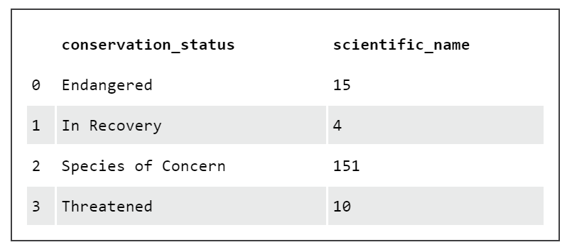
Conservation Status:
The table below shows the number of species within each status.
Well, we have a ton of concern here by species.

Slide 3
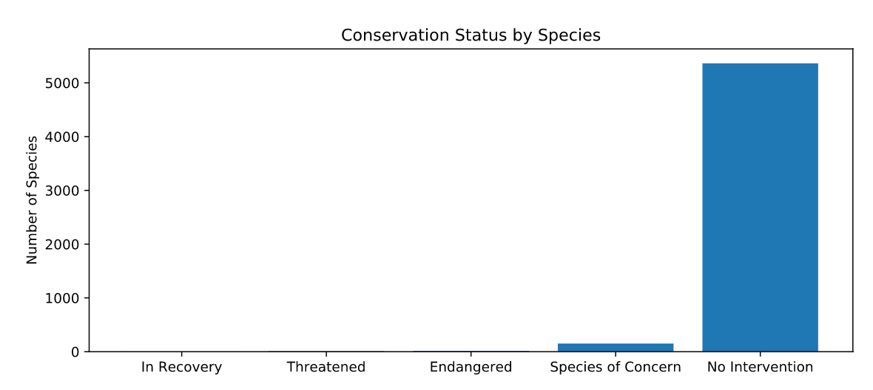
Wow! That’s a ton of Species that are currently seeing no intervention compared to our species of concern.

Slide 4
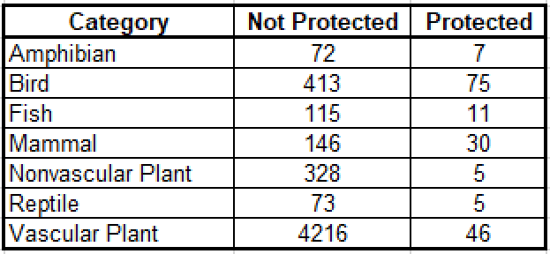
Protected Endangered species:
Vascular Plants & Birds have an immense population size to determine what is protected and what is not. They therefore hold the highest number of protected species by category. While they hold a ton, Nonvascular plants and Reptiles hold the smallest coming in at just 5 a piece.

Slide 5
Conservation recommendations:
We thought there is a quantitative difference in the percentages of birds and mammals that as protected species.
P-value of ~0.688 in our Chi-squared test showed that the difference between the percentages of protected birds and mammals is not significant and is a result of chance.
But, when we compared the percentages of protected reptiles and mammals and ran the same chi-squared test, we calculated a p-value of ~0.038, which is significant.
So after running the two separate tests it is safe to say that one species may be more likely to become endangered than another species.

Slide 6
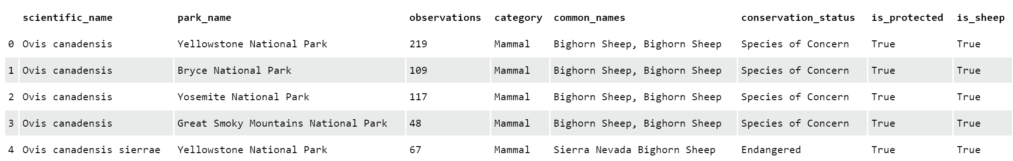
Observations from 7 days of Observations
Some observations by species are shown above. We are mostly seeing sheep in the snippet that are protected Mammals. Being mostly observed at Yellowstone National Park.

Slide 7
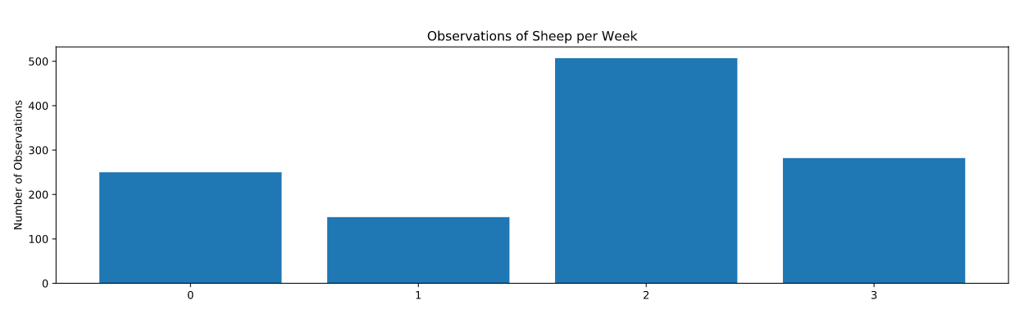
Sheep Observations
As you can deduce the number of sheep observations are consistently over 100 sightings for 4 straight weeks. We can see in week 3 we saw the most sheep with nearly 500 observations and that in week 2 we saw the least with nearly 150 observations.

Slide 8
Foot and Mouth disease
Our foundational rate of disease for this study is a 15% occurrence rate at Bryce National Park. The group we are analyzing data for want to know if a more than 5% drop is actually significant at Yellowstone park. Our sample size was 510 sheep.
We found this would take 1 week of observations at Yellow Stone Park and 2 weeks of observations at Bryce Park to see the necessary 510 sheep.
park_name | observations
Bryce National Park | 250
Great Smoky Mountains National Park | 149
Yellowstone National Park | 507
Yosemite National Park | 282

Slide 9
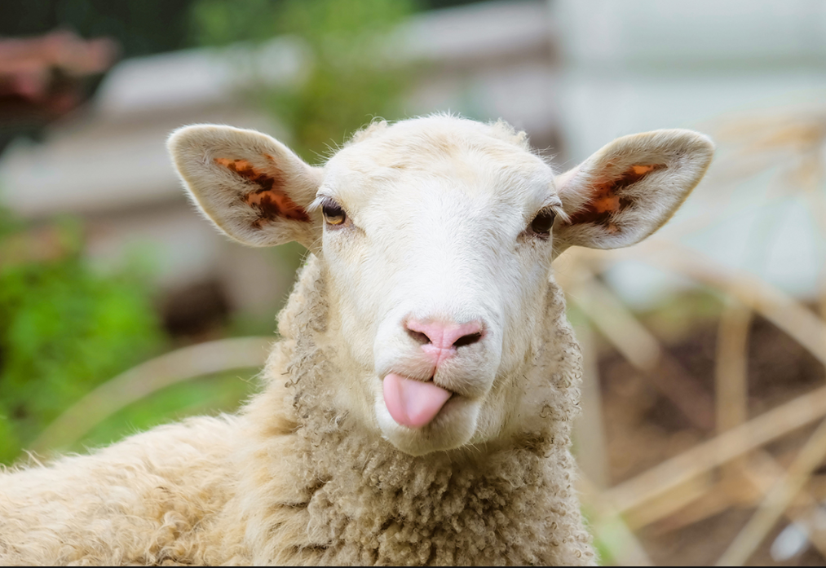
Thanks!

